Slide 1

Danor Sinai 311156616 Sahar Oz 311285514

Slide 2

Introduction to the Project
Problem Statement
In digital-age communities, the lack of a centralized platform for managing night watch operations and community engagement leads to fragmented, inefficient community functioning and reduced safety.
Need for the System
UrbanHive addresses the urgent need for a one platform that enhances community safety through efficient night watch management and promotes greater community interaction.
Notes:
לתת את הדוגמא של תחילת המלחמה שראש עיריית מוצקין חילק את העיר לרובעים

Slide 3

System Requirements
Core Features
Night Watch Scheduling: Coordinate and manage security shifts within the community.
Event Management: Organize and participate in community events seamlessly.
Real-Time Communication: Enable interactions via posts and comments among community members.
Account Management: Personalized user profiles and settings, secured with Auth0.
Scalability: Designed to efficiently handle a growing number of users and data.

Slide 4







Technological Solutions
Server Side
Python Flask is utilized for server-side operations, ensuring lightweight and efficient backend service.
Database
MongoDB, chosen for its flexibility and scalability, handles dynamic community data.
Client Application Developed using JavaScript and Expo React Native to ensure cross-platform compatibility.
Authentication
Auth0 provides secure and reliable user authentication. (TBD)
Notes:
להסביר כאן למה בחרנו בכל טכנולוגיה ומה היו המניעים לבחור בה.

Slide 5
Client Architecture
Client Architecture
Framework Used: Expo React Native
Design Patterns: MVC (Model-View-Controller) combined with Functional Programming and Component-Based Design
MVC Pattern Implementation
Model:
Contains API functions (e.g., apiUtils.js) managing server interactions.
View:
Includes the JSX files in the screens folder, rendering the UI components.
Using the data from the Model for dynamic content display.
Controller:
Embedded within JSX files, connecting Model's data functions to UI. Manages data flow and application logic directly.
Benefits of MVC Pattern
Improves how fast we develop by keeping different tasks separate.
Helps create strong and flexible app features.
Makes testing and growing the application easier.

Slide 6
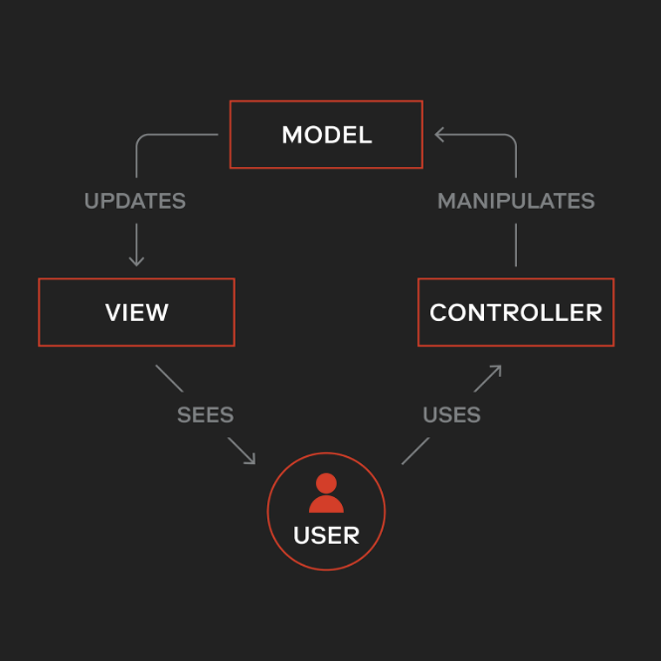
Client Architecture - UrbanHive – MVC Pattern

Slide 7
Server Architecture
Server Architecture
Framework Used: Python Flask
Architecture Style: RESTful
Main Functionality: Manages entities such as users, communities, posts, events, and night watches.
Service Layer Design Pattern
Endpoint Definitions:
Retrieval: GET requests to fetch data.
Creation: POST requests to add new entries.
Updating: PUT/PATCH requests to modify existing data.
Deletion: DELETE requests to remove data.
Role of Service Layer:
Handles business logic for CRUD actions.
Communicates directly with the MongoDB database.

Slide 8
Server Architecture - UrbanHive Project
Database Integration
Storage: Each entity stored in its MongoDB collection.
Benefits: Seamless storage and querying of structured and dynamic data.
Support Systems
Logging: Tracks activities of each function, assists in debugging and monitoring.
Testing: Comprehensive testing suite to ensure API reliability and functionality.
Benefits of Using Flask
Lightweight and Modular: Ideal for developing clear and effective RESTful APIs.
Ease of Data Manipulation: Provides a straightforward interface for interacting with complex data structures.
Notes:
דוגמה לcomplex data structure זה למשל הקולקישין של הCommunity שמכיל הרבה attributes שכוללים גם list של חברי הקהילה המקושרים לקוליקשין של היוזר.

Slide 9
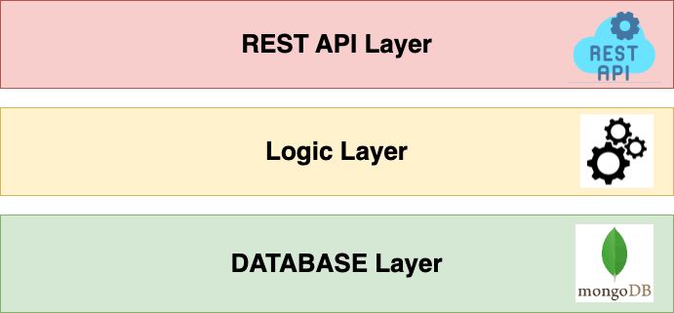
Server Architecture - UrbanHive – Service Layer Pattern

Slide 10
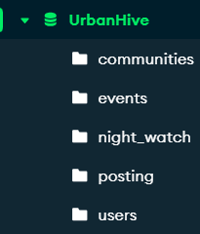
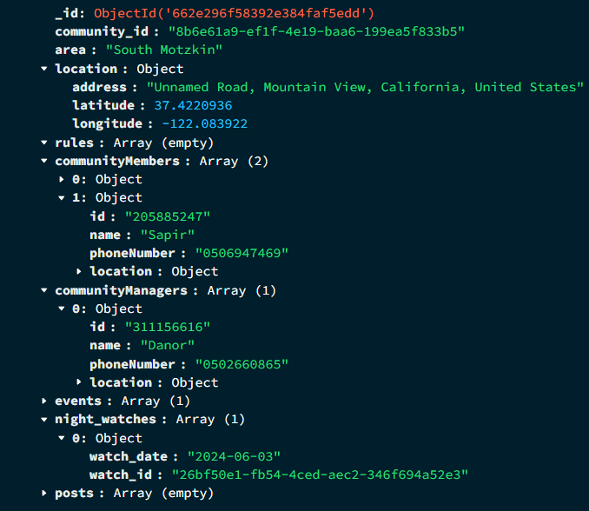
MongoDB
Dynamic Schema: Adapts to diverse data types and structures.
Scalability: Handles growing data volumes efficiently.
Performance: Optimized for fast data operations.
Geospatial Features: Supports location-based services.

Slide 11

Project Indicators and Compliance
Functionality and Objectives:
Achieved: The app effectively meets set objectives, enhancing community engagement and safety.
User Reach:
Achieved w: Successfully creating a large user base across multiple platforms with the using of Expo React Native
Architecture Compliance:
Achieved with Expo React Native & Python Flask:
Client App: Follows MVC design pattern.
Server: Implements a service layer, enhancing maintainability and scalability.
Data Security and User Authentication:
Failed: Implementation of secure data handling and authentication with Auth0 was not completed due to time constraints.

Slide 12

Challenges and Constraints
Resource Limitations: Limited development environments necessitated independent work and frequent integration, which introduced risks to lose the code and data.
UI/UX Design Constraints: we have no experciese with a UI/UX and design of an application to be a user friendly and simple to use.
GPS Disruption: Due to ongoing conflicts affecting GPS services, our app often incorrectly displays the user's location as being in Beirut instead of Israel. This impacts our feature that calculates interactions within a user's vicinity by using their actual location.
Notes:
Due to restricted development setups, I had to work alone a lot and merge changes often. This could be risky, but we handled it well by using Git to control versions.

Slide 13

Solutions
Resource Limitations: using Git for version control and our comptures to run both the client and server.
UI/UX Design Constraints: Lack of design experience was overcome by utilizing UI/UX templates and resources from Figma, enabling rapid and effective design implementation.
GPS Disruption: Utilize Android and iOS emulators to simulate and provide more accurate location data, ensuring our app functions correctly regardless of external disruptions to GPS services.
Notes:
Due to restricted development setups, I had to work alone a lot and merge changes often. This could be risky, but we handled it well by using Git to control versions.

Slide 14

Demonstration of the System
A video demonstration will show how UrbanHive functions in real scenarios, illustrating user interactions like signing up,login, organizing a night watch, writing a post and create your own community.
This demo will highlight the seamless integration of frontend and backend elements and the user-friendly interface.

Slide 15


Slide 16


Thanks for listening, any questions ?

